Slide 1
Annex G—Technical Advisory Committee Convenor’s Report

Slide 2
Technical Advisory Committee Convenor’s Report
27th Montreal Process Working Group Meeting, 13-17th November 2017
Tim Payn, TAC Convenor

Slide 3
Outline
Ecosystem Services
  Set up network
New Developments
Overview and Achievement Report

Slide 4

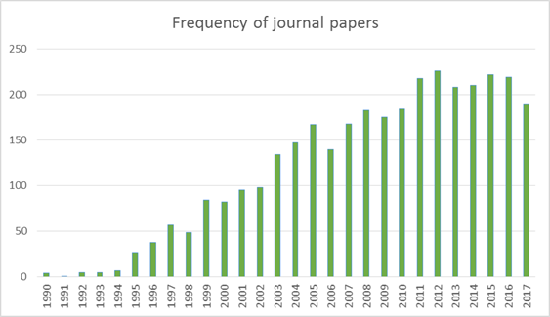
New Developments
Topic trend analysis
Montreal Process
Figure 1. Frequency of journal papers that refer to variations and combinations of sustainable forest management, forestry, criteria and indicators, and Montréal Process, based on the Scopus search engine
Emerging Areas
New uses of C&I
Continuous improvement of C&I

Slide 5
New challenges for temperate and boreal forests
Survey (https://www.surveymonkey.com/r/T8CCRRL) – there is still time to do the survey!
  5 biggest challenges for temperate and boreal forests in the next decade
    Climate change, land use pressure/competition, trade, promotion of timber/forest products, policy confidence
  5 biggest challenges facing your country’s forests in the next decade
    Climate change, natural disasters, pests/fire/invasive species, land use competition, skills shortage
Literature
  Climate change, industrial development, biodiversity loss, fire/insects and invasive species, land use pressure
Montreal Process

Slide 6
Emerging topics
New Uses
Using the C&I to respond to major challenges facing temperate and boreal forests, such as climate change or human disturbance
Use of the C&I framework for complex systems analysis
Better understanding public attitudes and perceptions of SFM
Development of a global picture for temperate and boreal forest trends (with other Processes such as Forest Europe)
Use of C&I for forecasting futures: prospective SFM rather than retrospective.
Improvement of Existing C&I
Performing a SWOT analysis on the MP C&I framework
Performing risk analyses on the indicators related to ability to detect trend and likelihood of impact of that trend
Consideration of how indicators are networked and the concept of SFM as a complex system
Better understanding the effectiveness and impact of MP reporting
Consideration of data custodianship

Slide 7
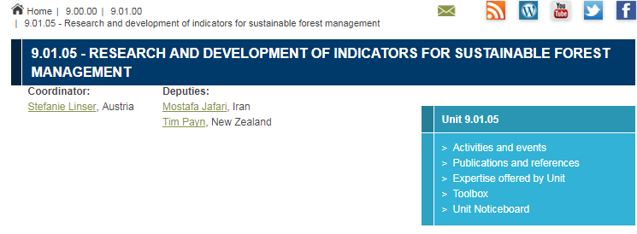
Different ways of working for the TAC
  TAC a small core group to respond to Working Group directions
  Regular scan of developments in C&I
  Respond to specific WG directives
  Facilitate access to technical experts
TAC to work closely with IUFRO Working Party on Criteria and Indicators to expand capacity on specific technical topics

Slide 8
Overview and Achievement Report
The report follows the direction of the 26th Working Group meeting: ‘The Working Group agreed the report should be concise (8 pages) and should focus on MP impacts, achievements, and future aspirations with links to concise 2-page country achievements that are readily updatable.’
The audience the report is written for are ‘decision makers, policy analysts, management and professionals’.
Individual countries drafted the specific 2 page summaries supporting the body of the report. They followed the headings of:
  Changes in Forestry since 1995
  The contribution of the MP C&I to those changes
  Future aspirations for use of the C&I framework
It is recommended that members:
note and discuss progress, provide feedback for completion of the comprehensive overview report, and consider the timing, resourcing and publication of the report

Slide 9
Finalisation of the report
NEXT STEPS
Comments on the draft to TAC Convenor – during or post Working Group meeting
Comments received
  Audience, style and readability, publication medium – digital/paper; more ‘Ooomph’ around Futures Section; highlight CFRQ and collaboration successes more
Countries to review and finalise their 2-3 pagers
Graphical layout and technical editing
Review by WG and finalisation

